Slide 1

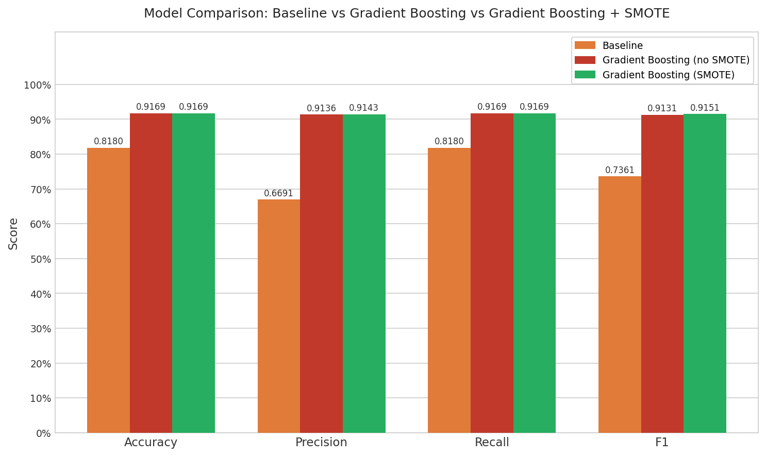
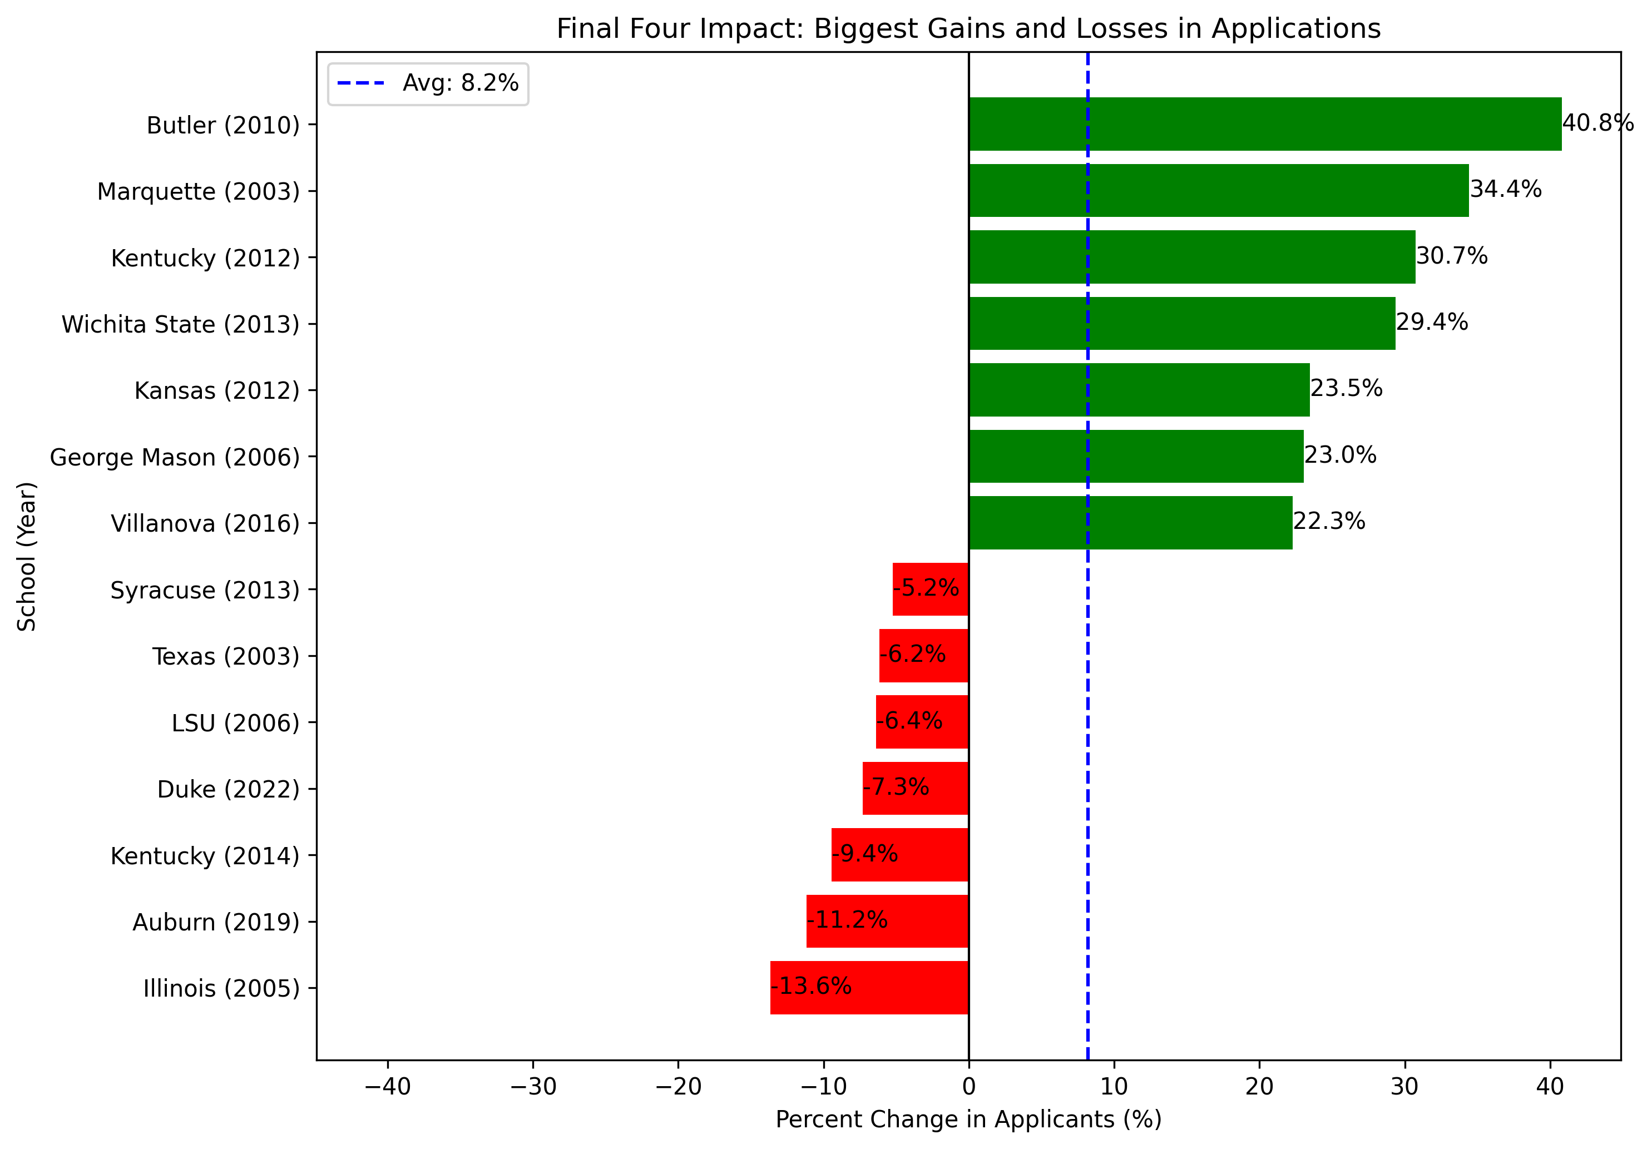
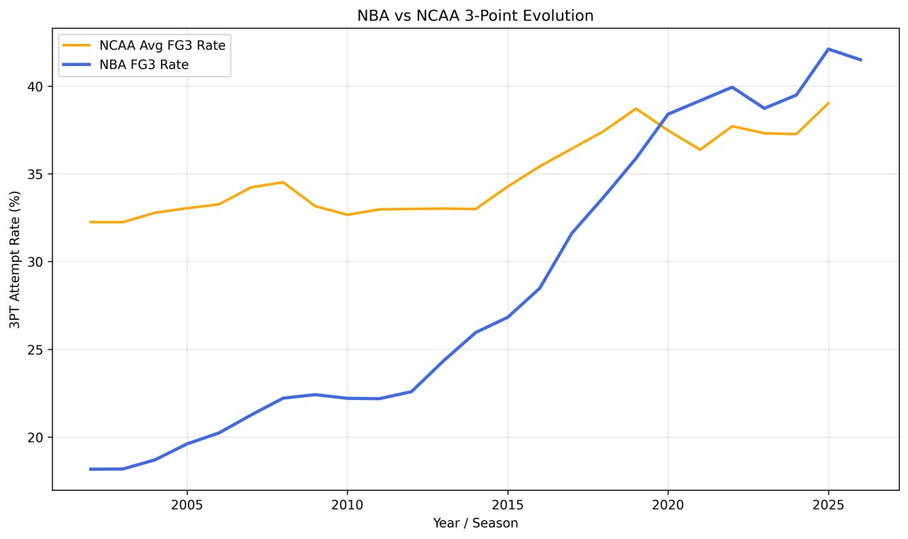
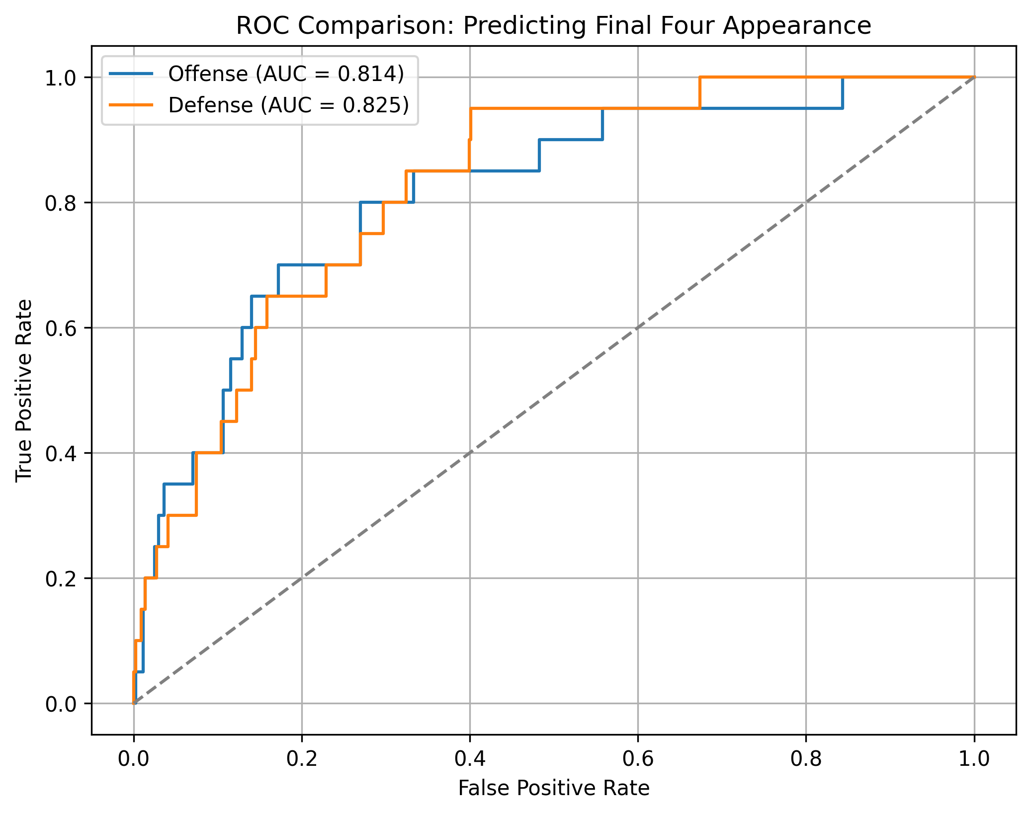
Predicting March Madness appearances and analyzing historical trends
Bill Stanton, Joseph Shin
Introduction
Data Sources
Model Performance
The goal of this project was to predict March Madness Final Four appearances for men’s NCAA teams. We trained a variety of machine learning models in addition to performing exploratory data analysis to identify unique patterns in the data.
The data was sourced from Kaggle, the NBA, and the National Center for Education Statistics. The data was cleaned, transformed, and subsetted before being used to train the model and create the Exploratory Graphs.
We built a Gradient Boosting model to predict whether a team will make March Madness. Because the dataset was moderately imbalanced (18% minority class), we used Synthetic Minority Over-sampling Technique (SMOTE) which increased the minority class from 18% to 35%. Implementing smote slightly increased the precision and f1 score.
Exploratory Findings
We used 3 questions to drive our analysis of the dataset:
Does a Final Four appearance impact the number of applications for a school the following year?
Does the NCAA follow the NBA’s increase in 3-point shooting rate?
Which statistic is a better indicator of a team making the final four? An efficient offense or defense?
Notes:
Speaker Notes:
Application Change Graph
Of the 7 schools with the largest increases in enrollment, 5 are relatively small (~10k or less)
Of the 7 schools with the largest decreases in enrollment, all are large schools (>20k)

